Slide 1

Ground Truth Problems in Business
Andrés Corrada-Emmanuel
Data Engines

Slide 2
github.com/andrescorrada/ground-truth-problems-in-business

Slide 3
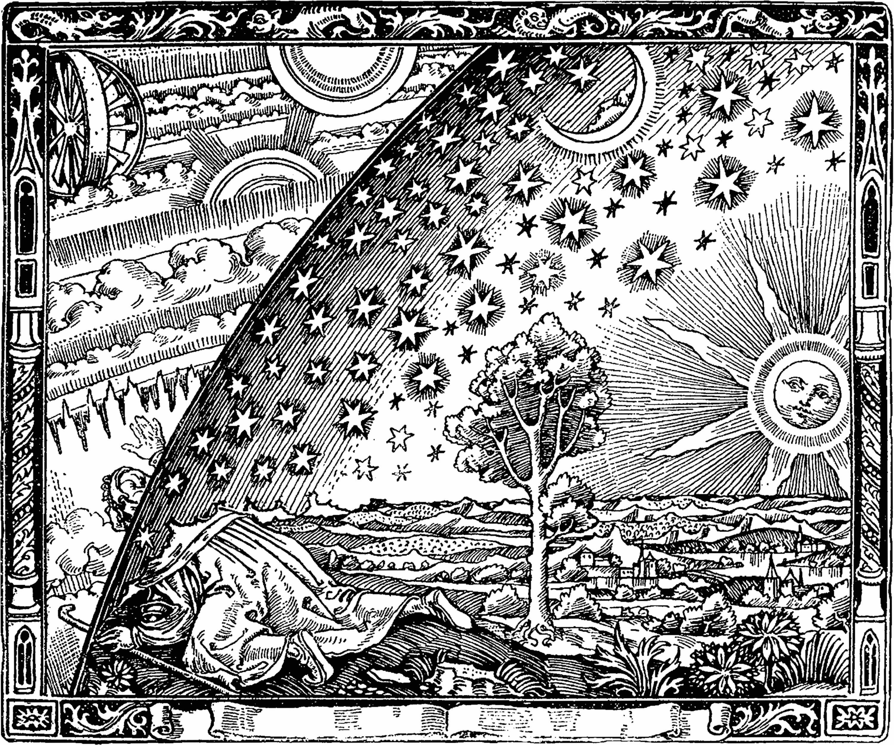

Slide 4
No Ground Truth because data is recent

Slide 5
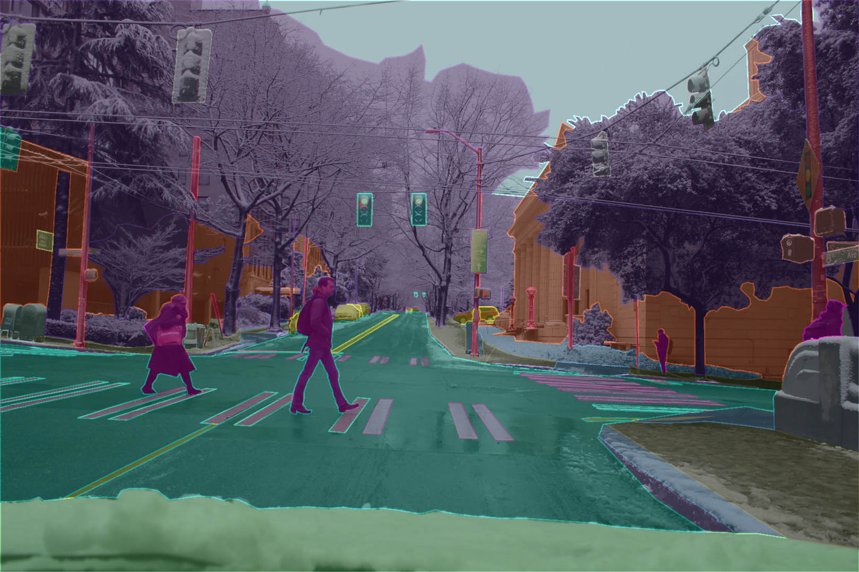


Slide 6
No Ground Truth because it is expensive to get

Slide 7
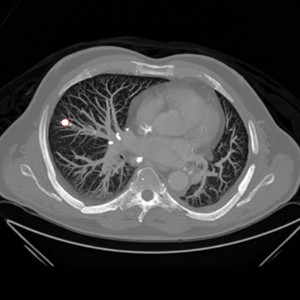


Slide 8
The journey of ground truth solutions
Measurement
Diagnosis
Solution

Slide 9
Statistics of Ground Truth
Statistic(answer key, student exam) = grade
Statistic(labels, classifications) = accuracy

Slide 10
The value of ground truth statistics in business

Slide 11
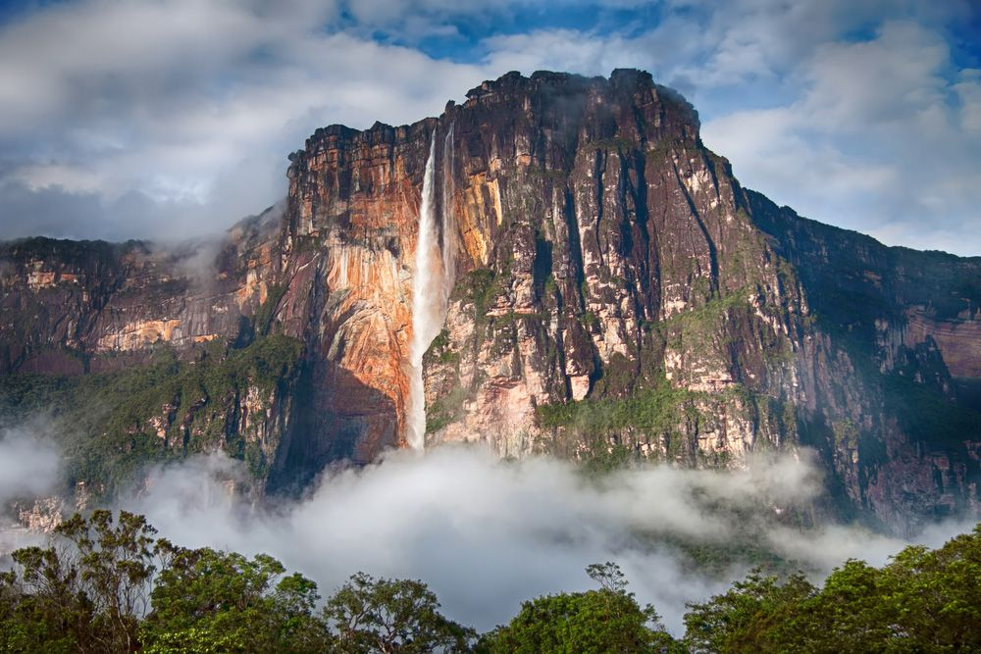

Slide 13
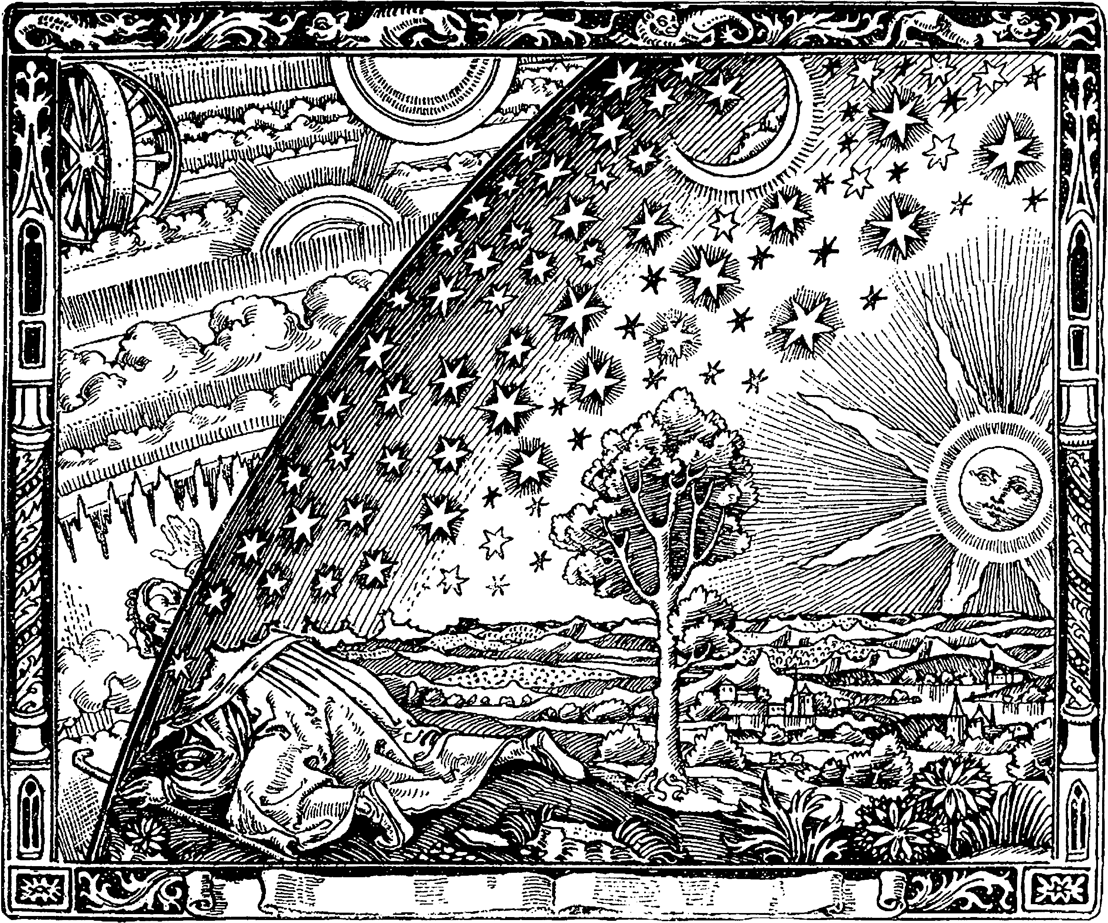

Slide 14
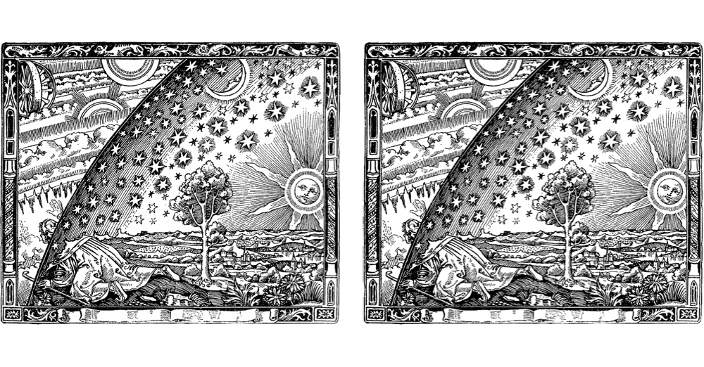
Original
Binarized

Slide 15

Original
Binarized

Slide 17


Slide 18


Slide 19


Slide 20
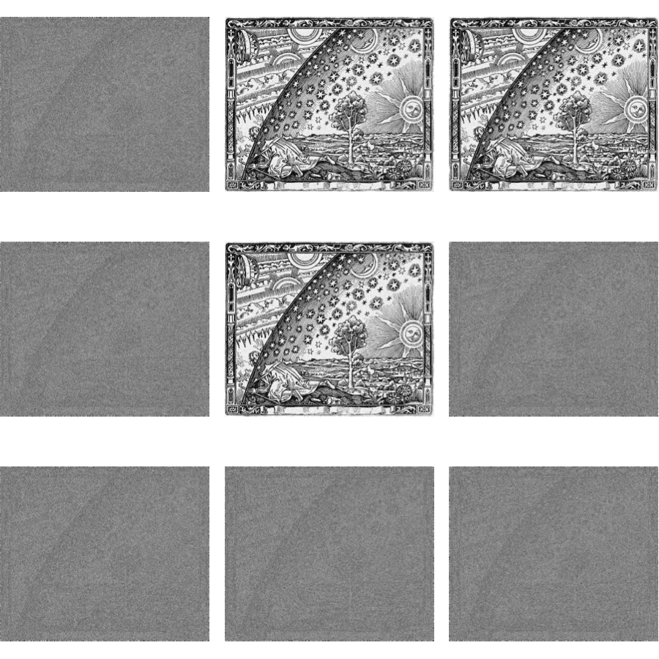

Slide 21
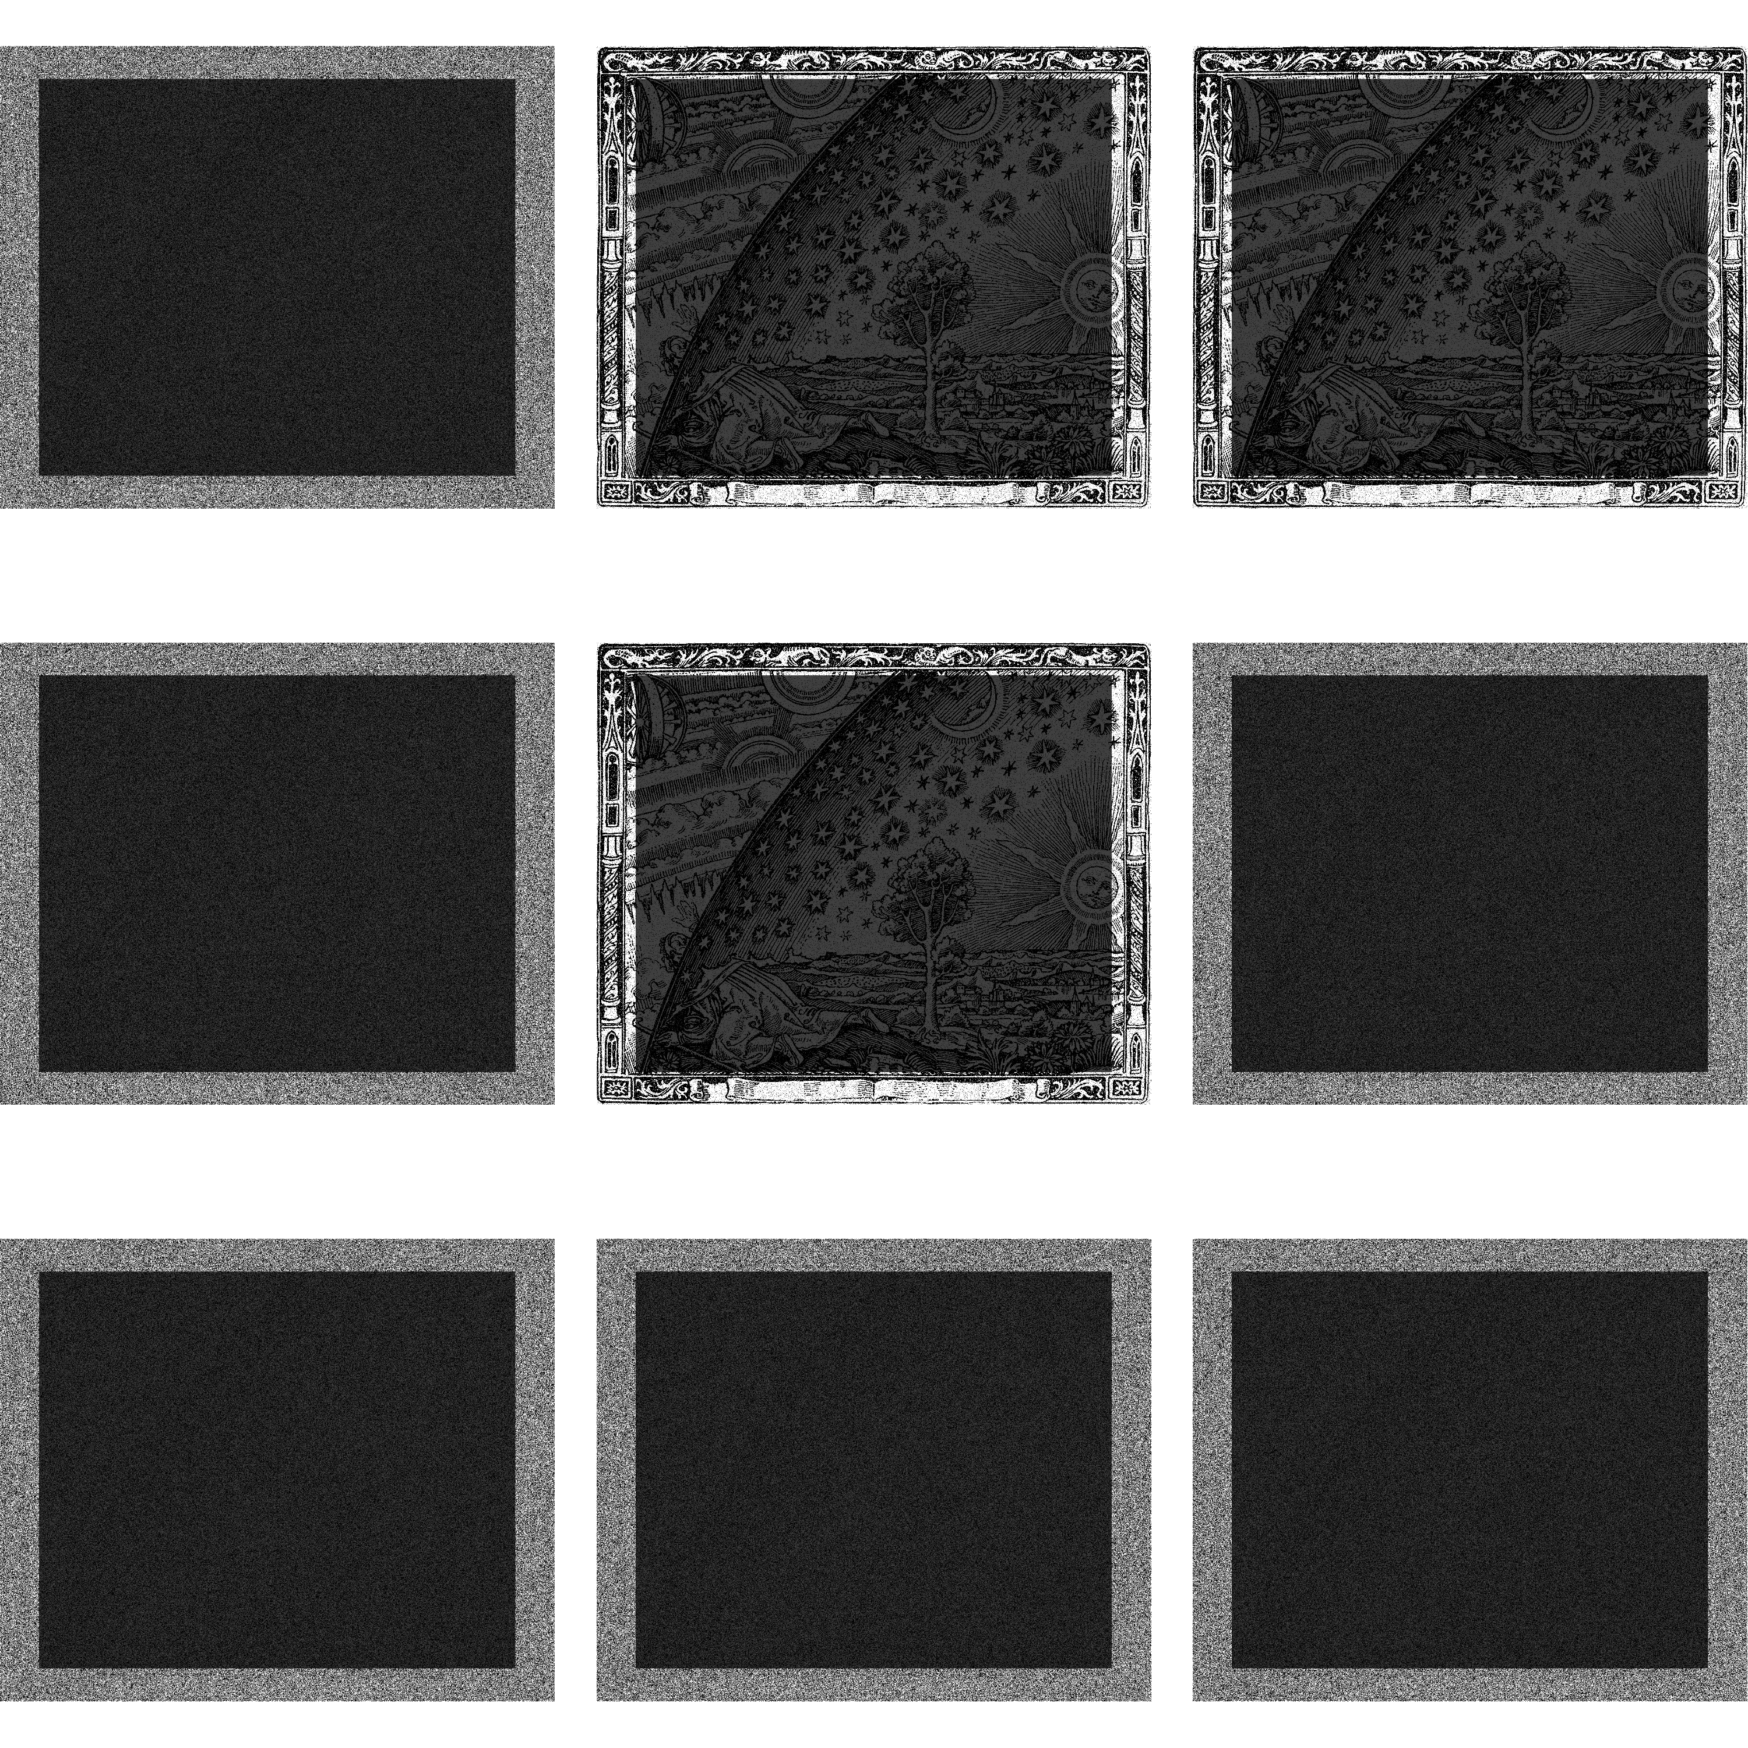

Slide 22


Slide 23
Ground Truth
Wisdom of the Crowd

Slide 24
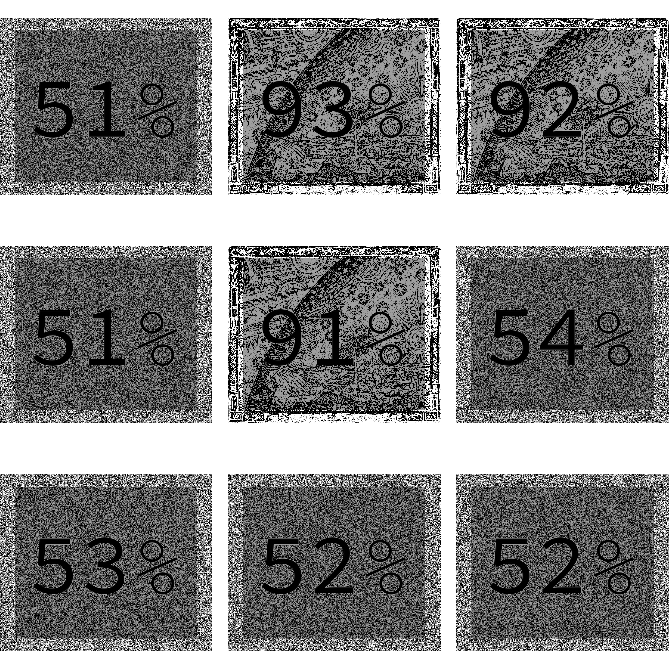

Slide 25


Slide 26
Ground Truth
Best Three

Slide 27

88% reduction in errors
Wisdom of the Crowd
Ground Truth
Best of Three

Slide 29
The Ground Truth is out there, it’s just too large

Slide 30
Data Stream Algorithms - refusing to remember ground truth

Slide 31
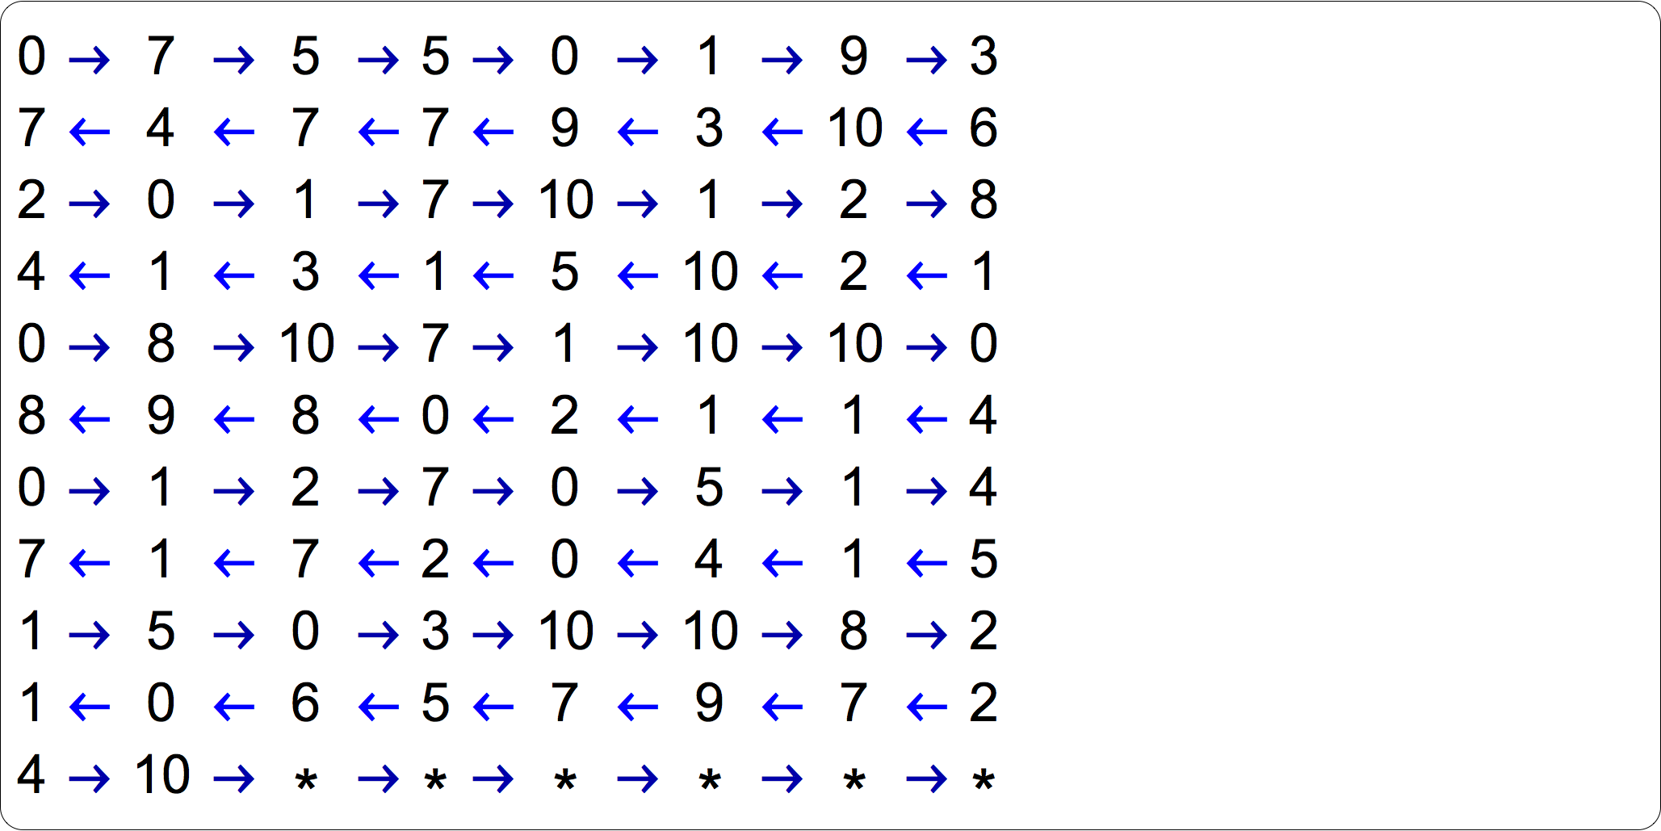

Slide 32
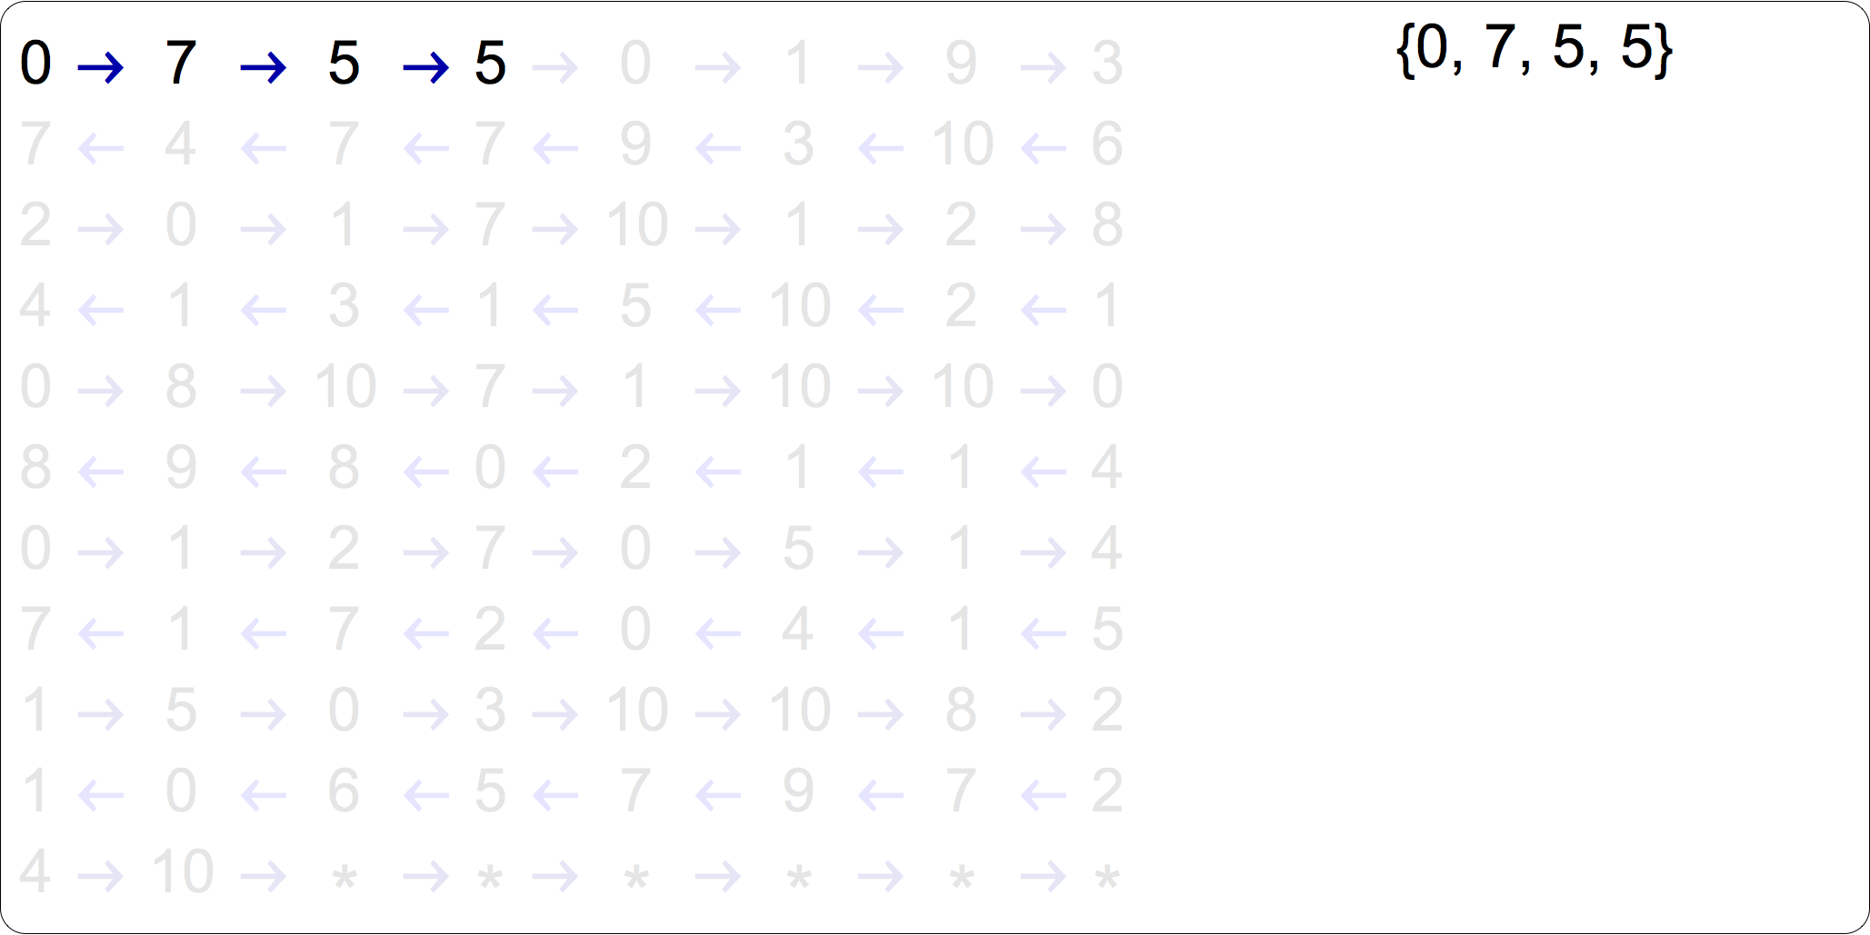

Slide 33
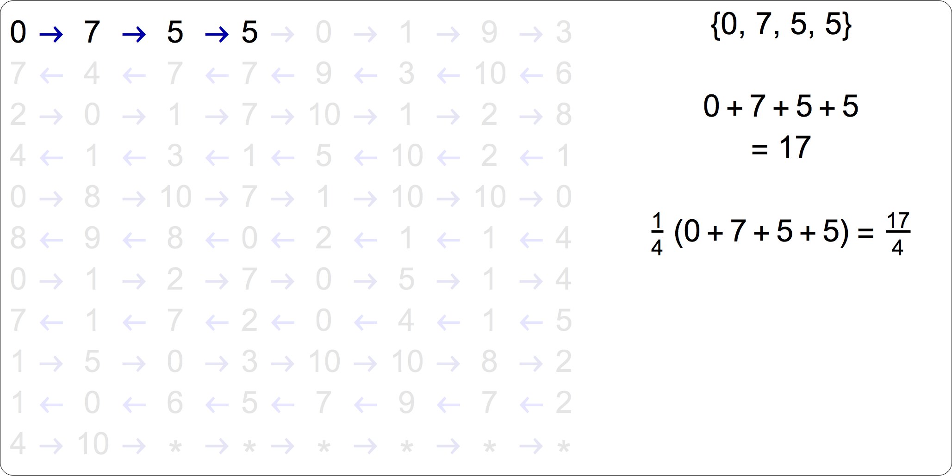

Slide 34
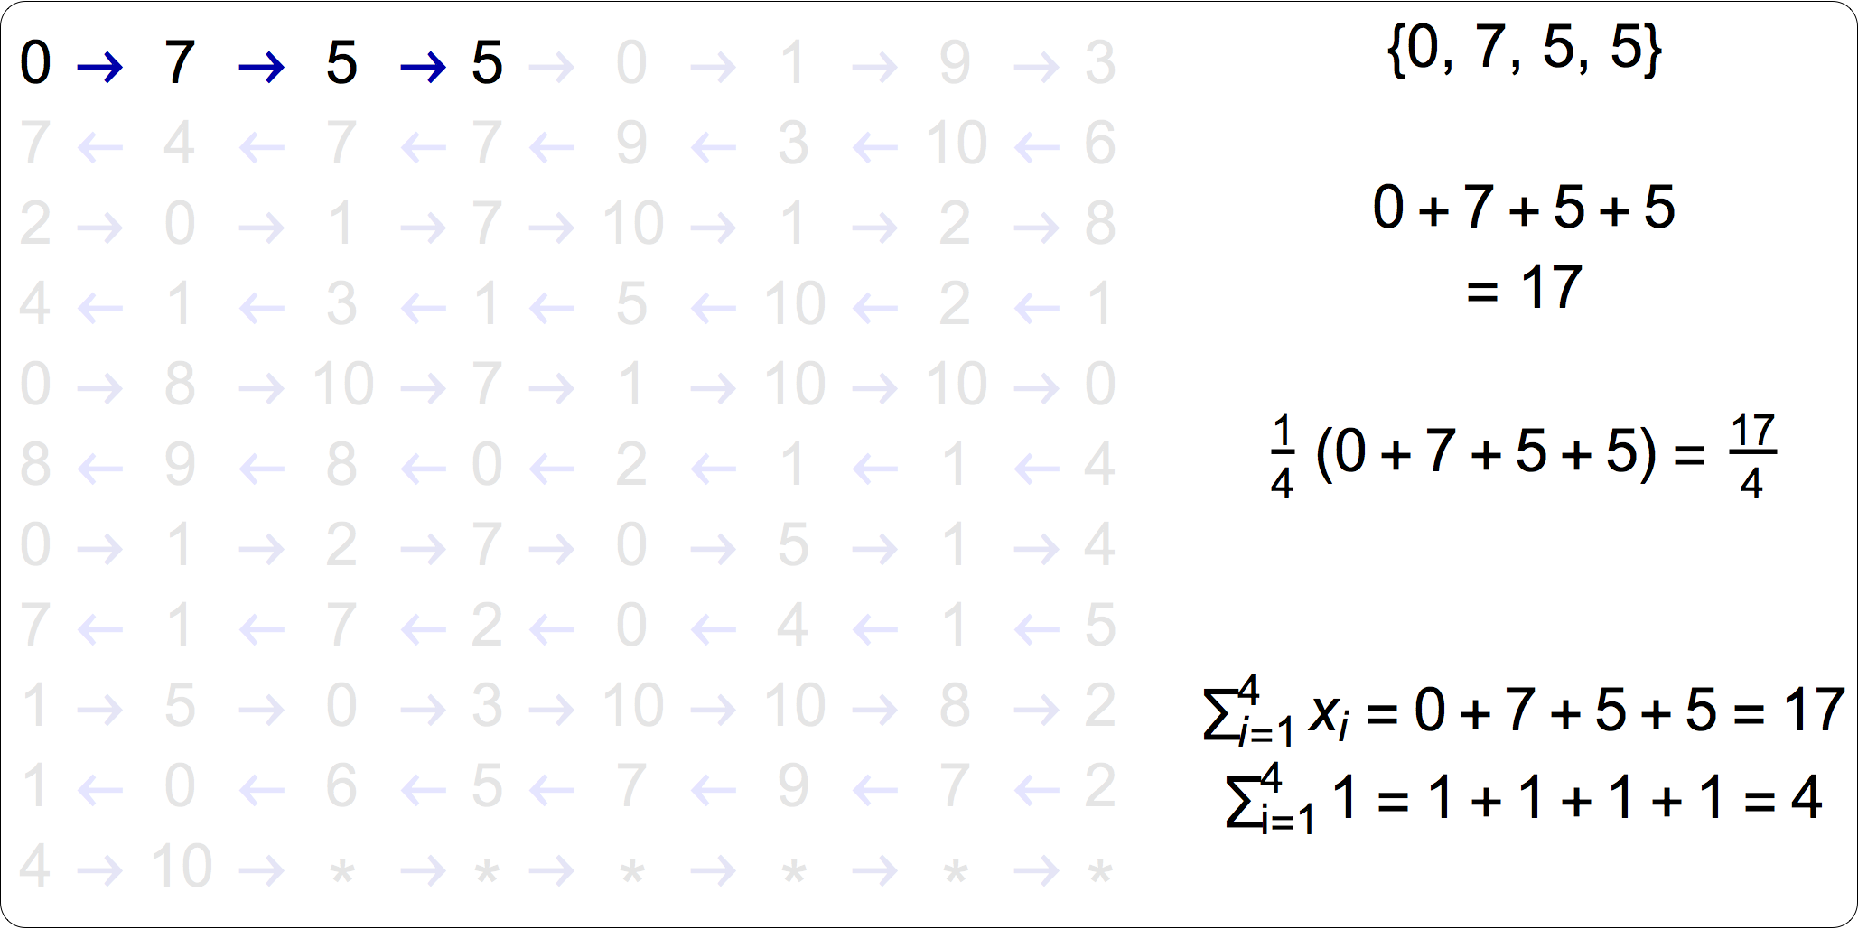

Slide 35
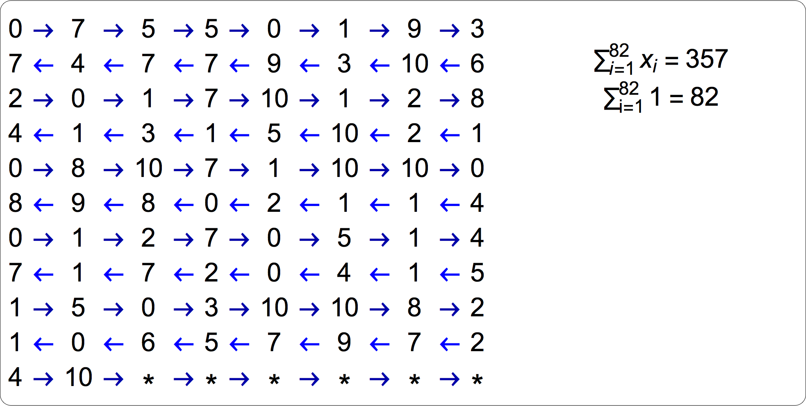

Slide 36
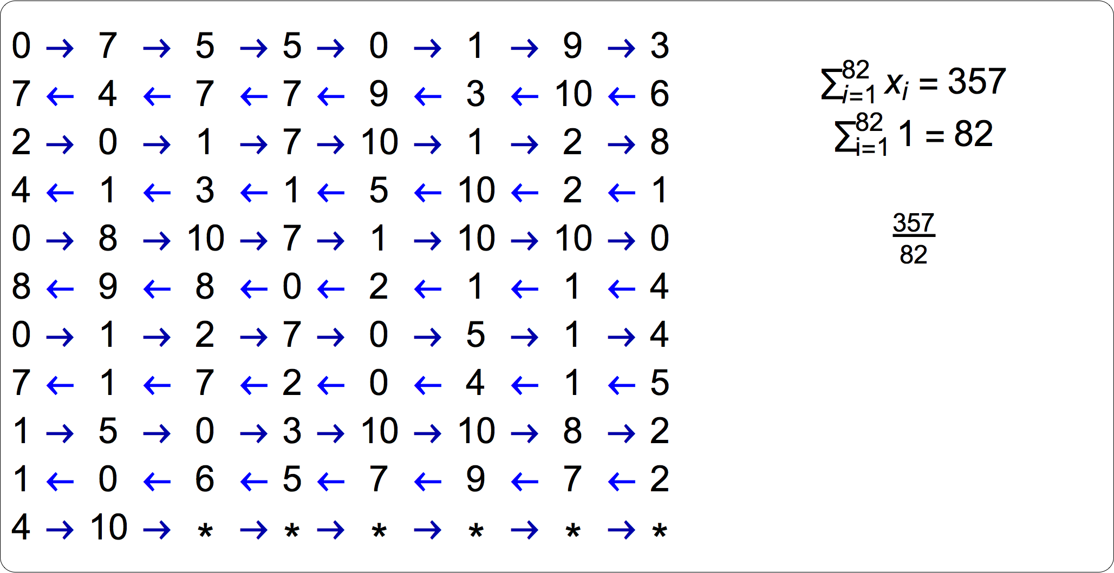

Slide 37
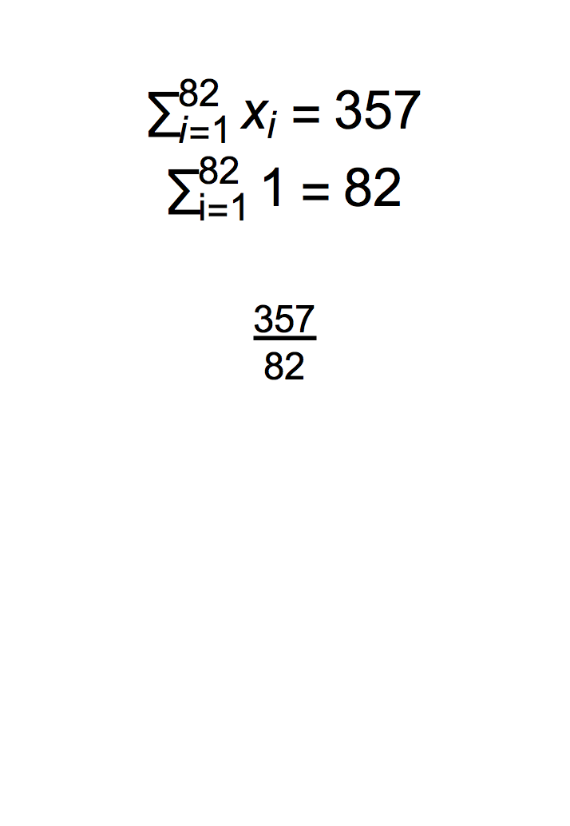
Compressive
Private

Slide 39
Grading an exam without the answer key

Slide 40
A question from a multiple-choice exam
“Do you need ground truth to calculate a statistic of it?”
“Yes”
“No”

Slide 41
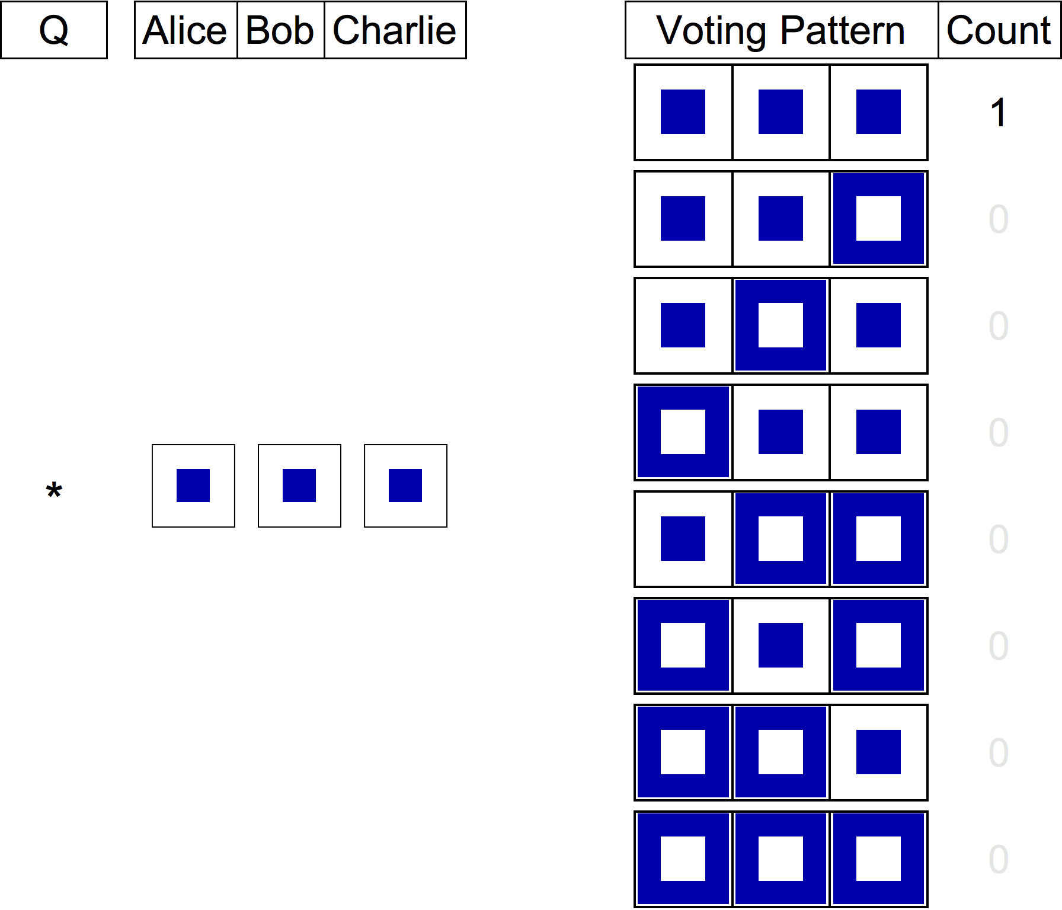

Slide 42
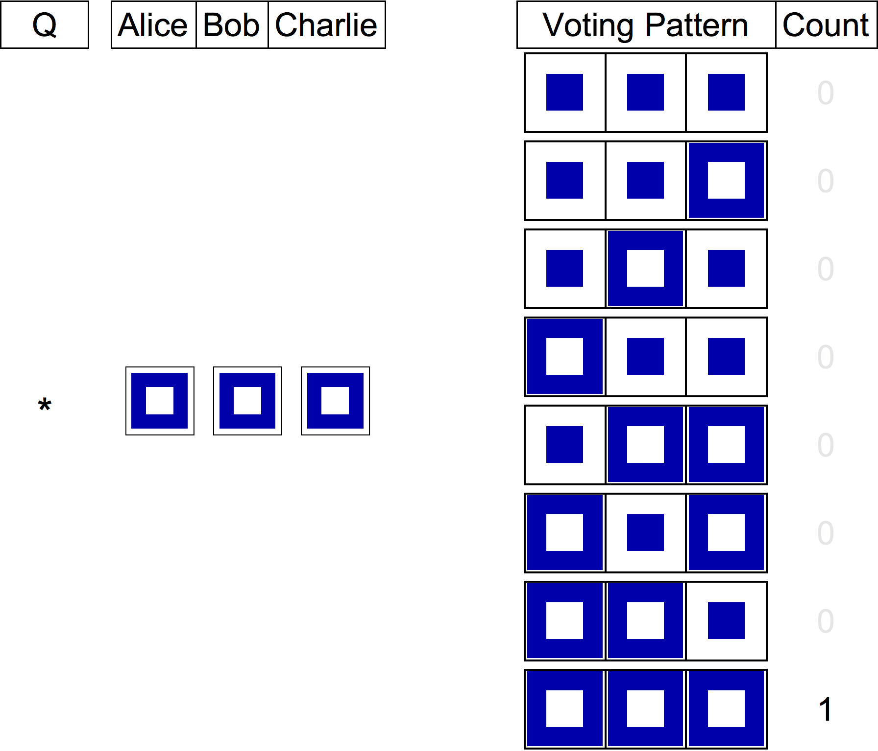

Slide 43
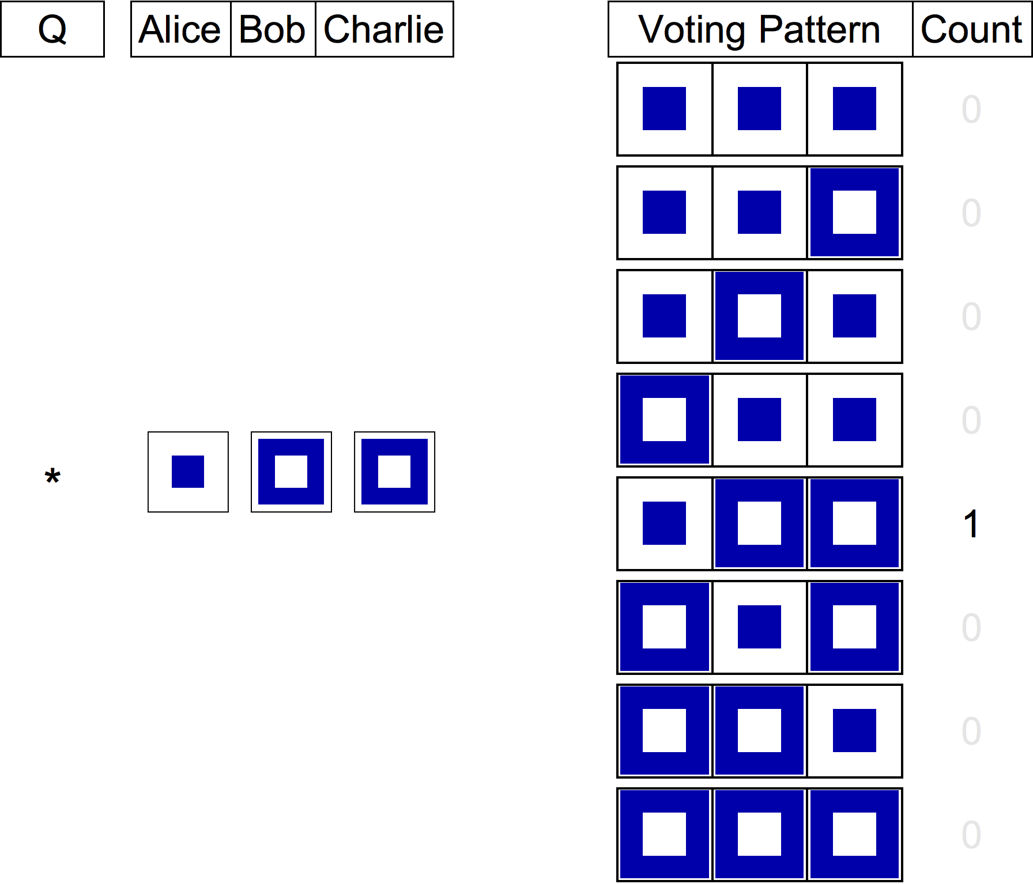

Slide 44
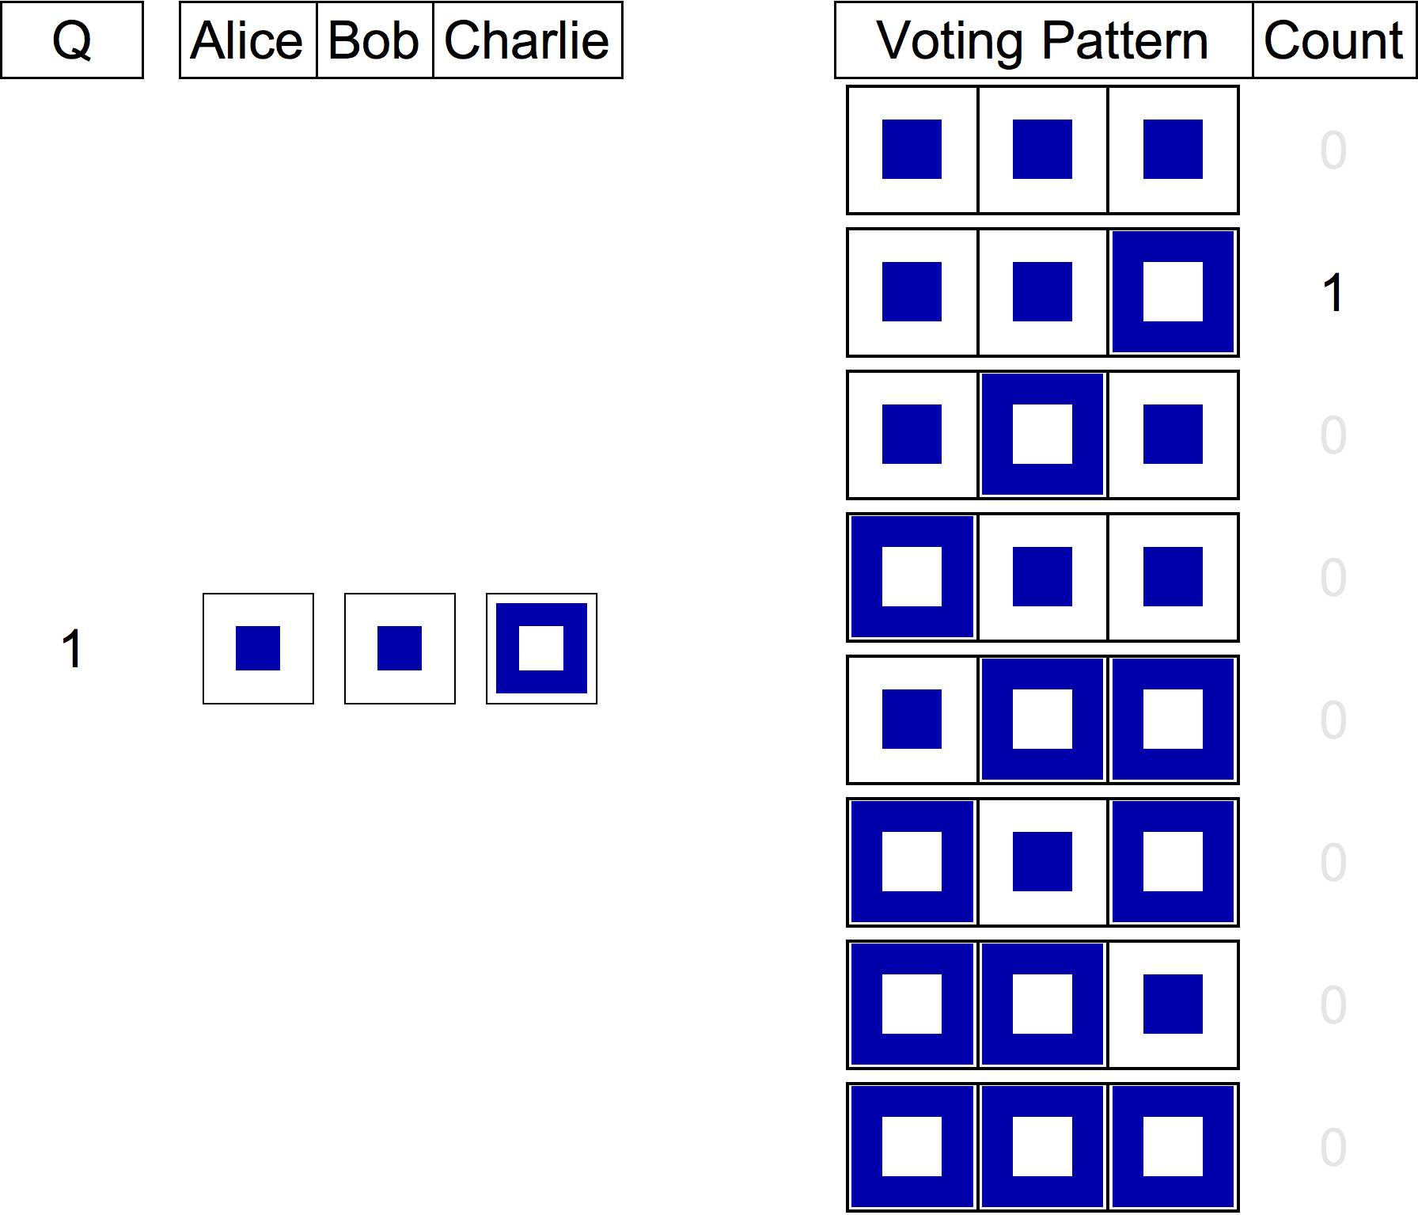

Slide 45
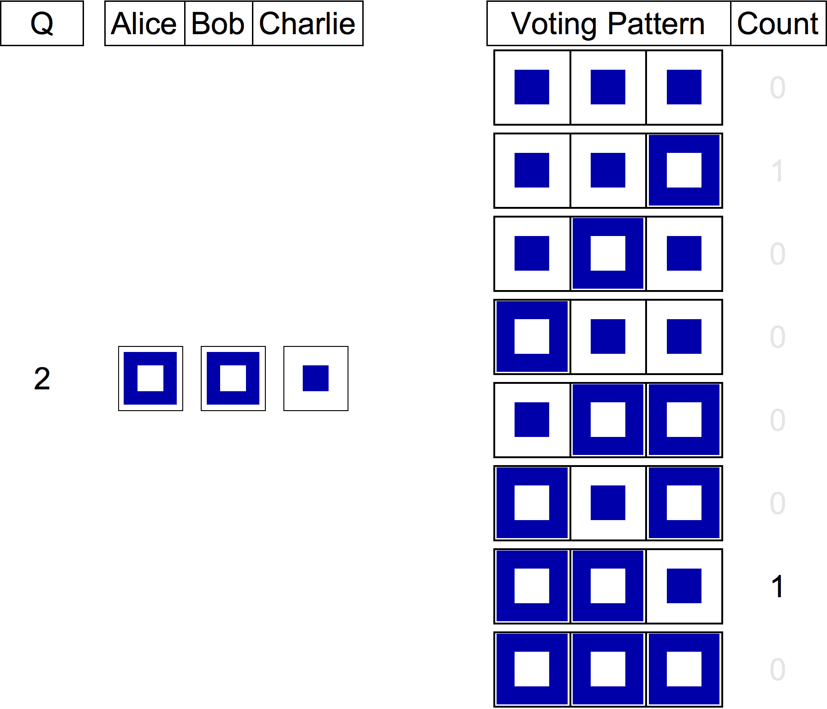

Slide 46
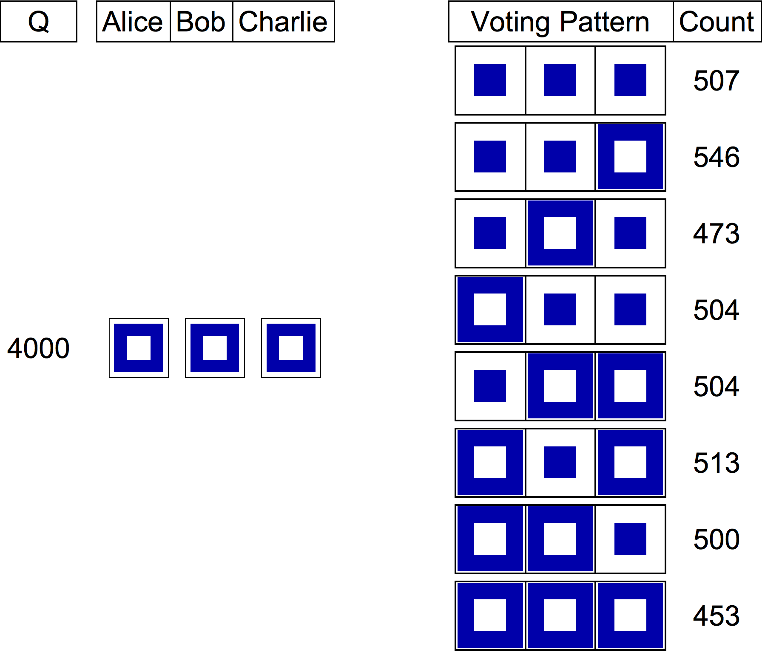

Slide 47
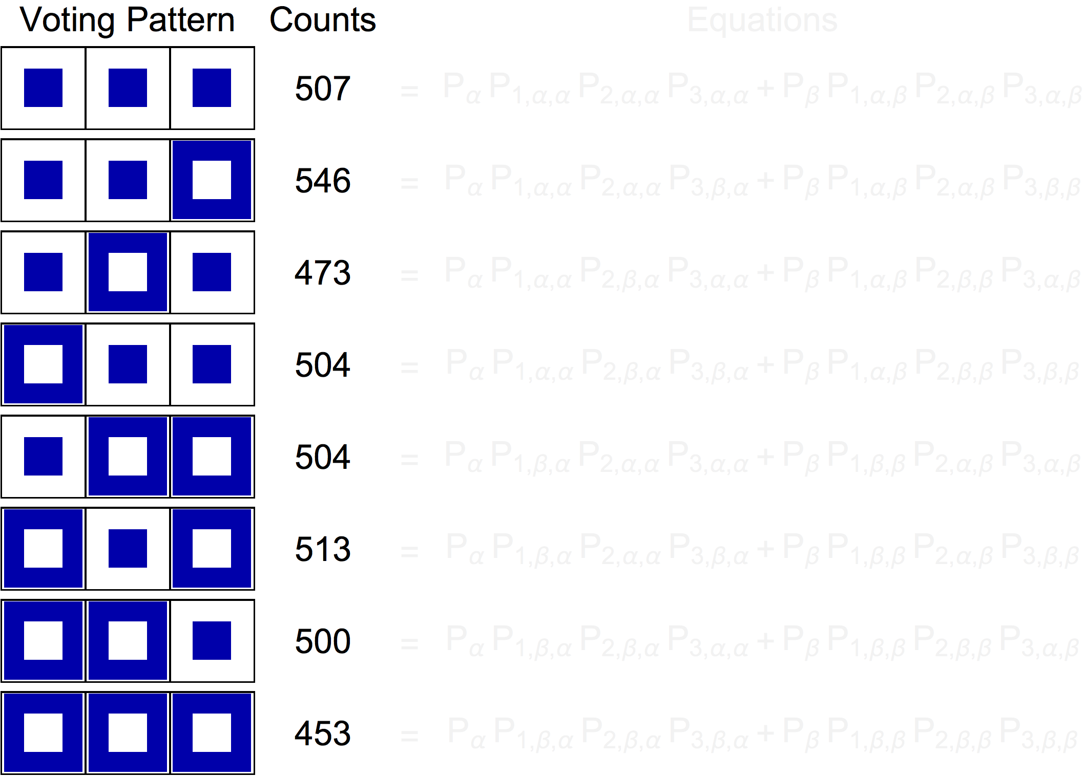
Compressive
Private

Slide 48
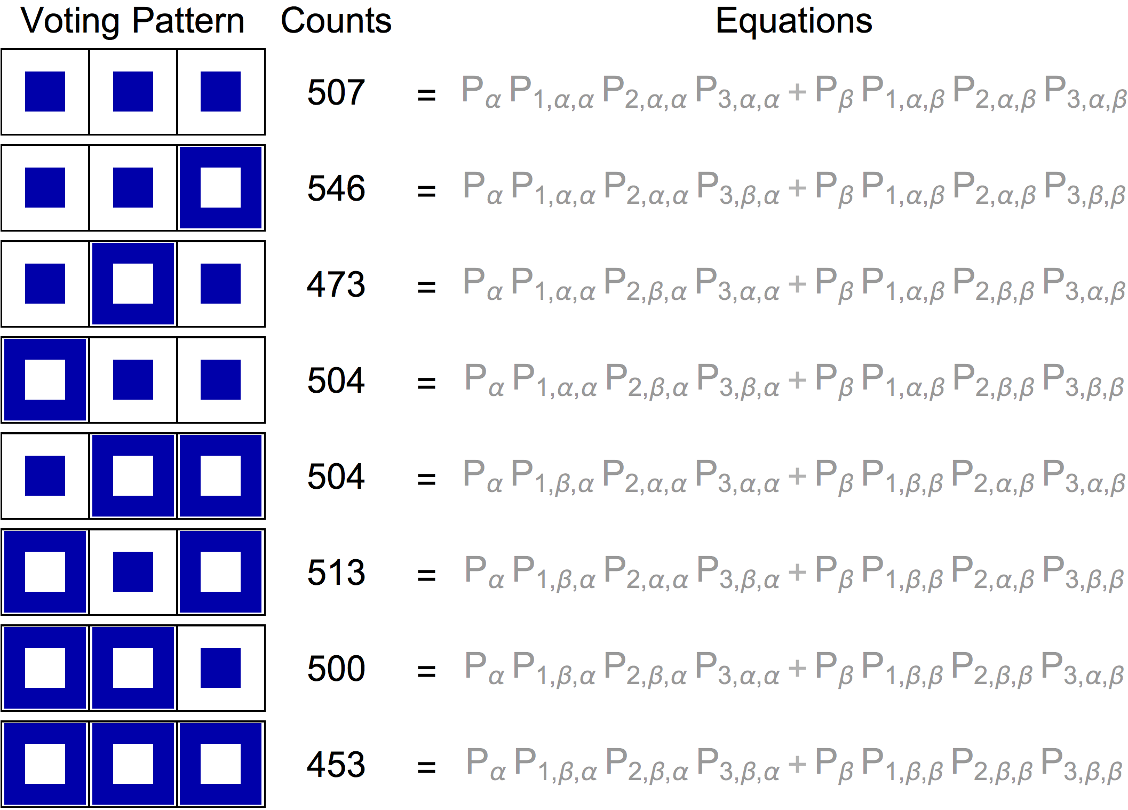

Slide 49
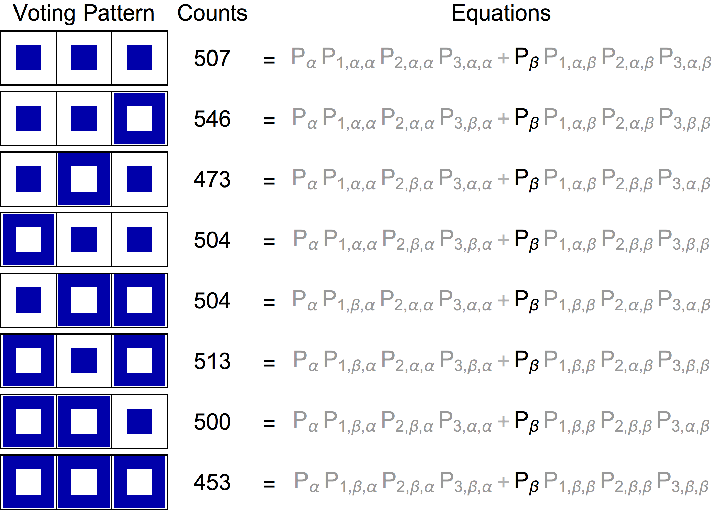

Slide 50
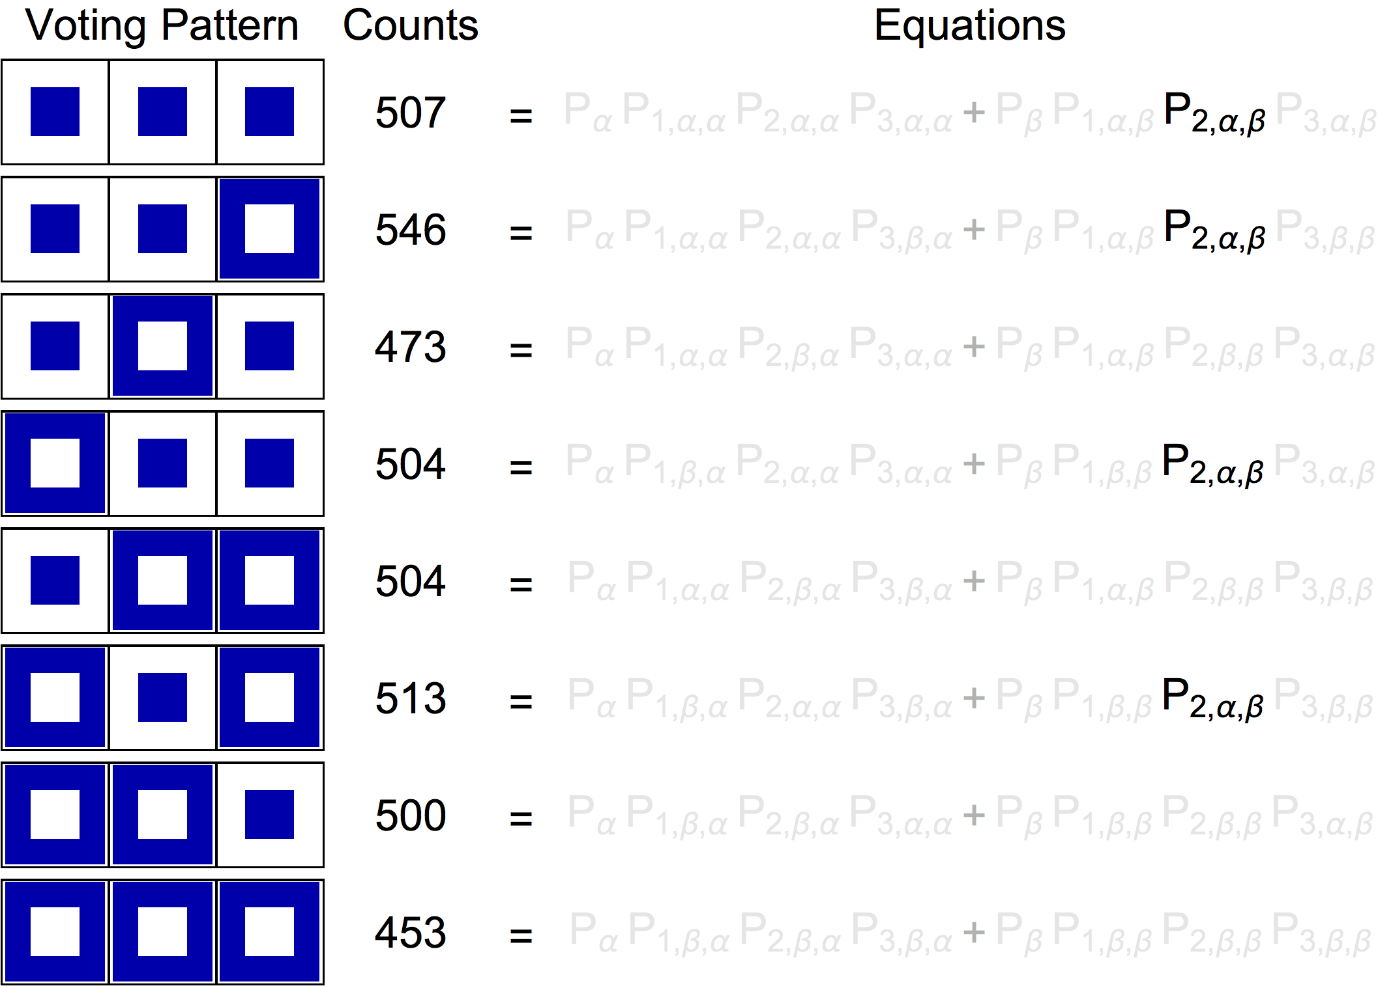

Slide 51
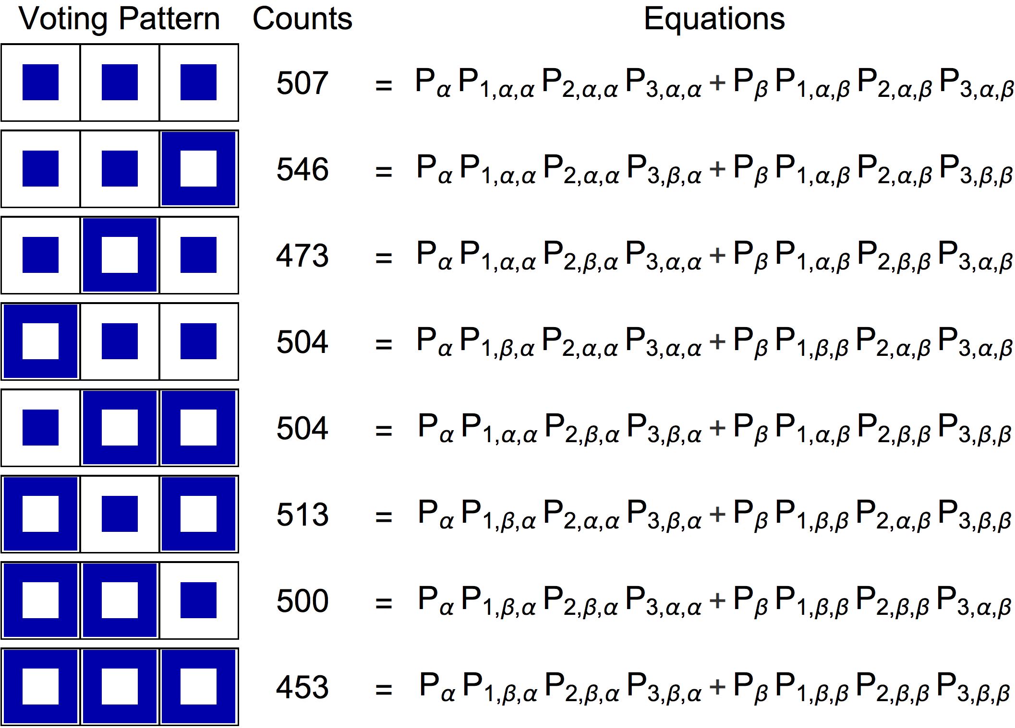

Slide 52
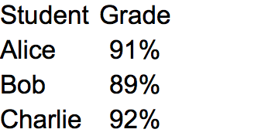

Slide 53
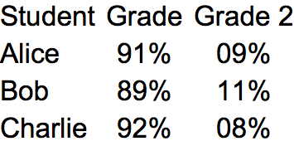

Slide 54
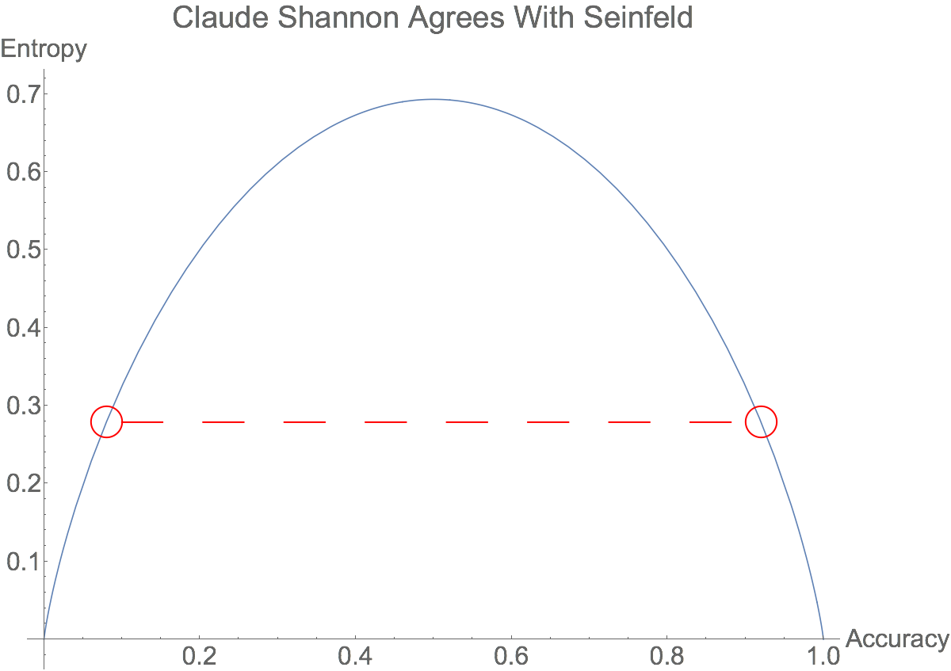
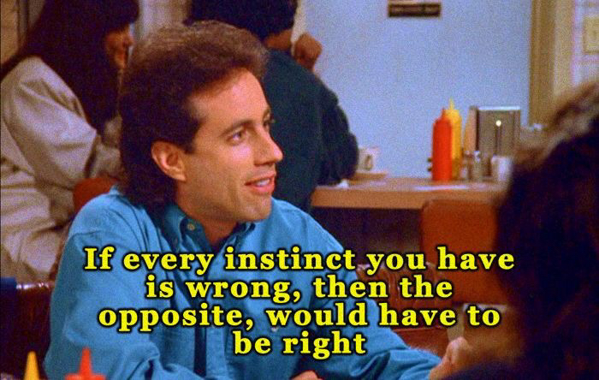
The Opposite

Slide 55
Why 4,000 Questions?
Correlations!
Small ground truth size or non-independent classifiers require a different model .... Our secret sauce.

Slide 56
Ground Truth for Regressors

Slide 57
Ground Truth for Regressors

Slide 58
Ground Truth for Regressors

Slide 59
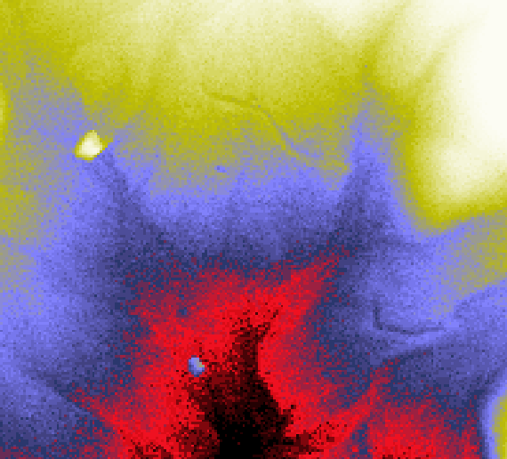
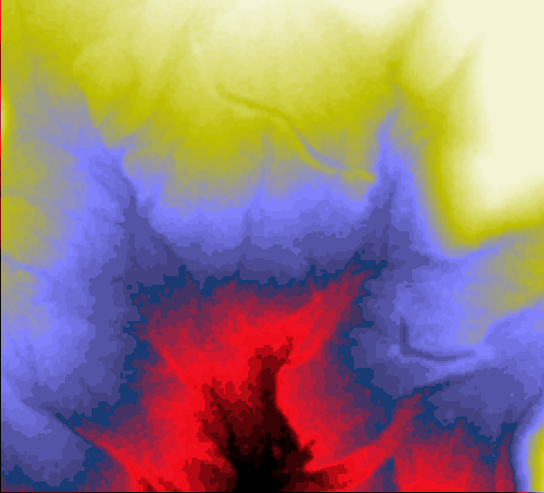

Sample DEM Fused DEM
Low
High
Elevations
Blunders are removed and noise is reduced

Slide 60
Thank You!
github.com/andrescorrada/ground-truth-problems-in-business

